Slide 1
Lambda Expressions
Shristi Technology Labs

Slide 2
Contents
Overview of Functional Interface
Example
Lambda Expressions

Slide 3
Functional Interface
An interface with only one abstract method - Functional Interface
May or may not be annotated with @FunctionalInterface
Few Functional Interfaces
Runnable
Comparable
Comparator
Function<T,R>
Predicate<T>
Consumer<T>
Supplier<T>

Slide 4
Functional Interfaces
The java.util.function package has 8 functional interfaces.
Function
BiFunction
Consumer
BiConsumer
Supplier
Predicate
BiPredicate

Slide 5
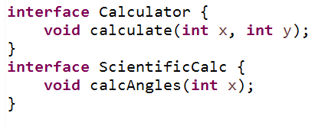
Example

Slide 6
Lambda Expressions
Is defined as a method without name, access specifier, return type.
Make the code writing simple, short and readable.
Short way to write the method in the same place where it will be used.
Used with functional interfaces.
eg.
Using Lambda
public int add(int x, int y){
return x+y;
}
public void greet(){
System.out.println(“Hello World”);
}
(int x, int y) -> {
return x+y;
}
() ->System.out.println(“Hello world”);

Slide 7
Syntax
(parameter) -> expression
(parameters) -> {statements};
()->expression
(arg1, arg2 . . . ) -> { body }
(type1 arg1, type2 arg2 . . .) -> { body }
( int a, int b ) -> { return a+b; }
() -> System.out.println ( “Hello World”);
(String S ) -> { System.out.println (s) ; }
(a,b) -> { return a+b } ;

Slide 8
//no argument - single statement, no curly braces
() -> System.out.println ( “Hello World”);
//one argument - single statement with curly braces
(message ) -> { System.out.println (message) ; }
//with two argument and types
(int a,int b ) -> { return a*b; }
//two arguments - multiple statements
(a,b) -> {
int sum = a+b;
return sum;
}
Lambda Expressions

Slide 9
Functional Interfaces
Runnable
Comparable
Comparator
Function<T,R>
Predicate<T>
Consumer<T>
Supplier<T>

Slide 10
@FunctionalInterface
public interface BonusCalculator {
public void calcBonus(int x);
public default void greetMessage(){
System.out.println(“default method ");
}
public static void Check(){
System.out.println("static method ");
}
}

Slide 11
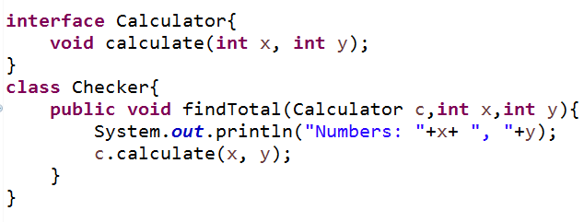
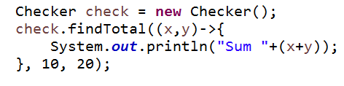

Example

Slide 12
Contents
Overview of Functional Interface
Lambda Expressions

Slide 13
Find all substrings of a given string
h | e | l | l | o
hellohell
hel
he
h
ello
ell
el
e
llo
ll
l
lo
l
o

Slide 14
Thank you

